Slide 1
REHABILITATION TECHNIQUES
TOM M. NTHIANI Bsc PT

Slide 2
OBJECTIVES
Explain rehabilitation techniques
Identify cases that require orthopedic technologist
Identify cases that require physiotherapist
Identify cases that require occupational therapist

Slide 3
SPECIFIC OBJECTIVES
By end of the session, students will be able to understand:-
Definitions, terminologies & rehabilitation
Types of orthopedic appliances, indications & biomechanics
Forms of PT, benefits & contraindications
Forms of OT, roles, benefits, indications & contraindications

Slide 4
REHAB IN ORTHOPEDICS
Improved results in # treatment owes much to rehabilitation, which is most important of the 3 principles of # management (Reduction, immobilization & rehabilitation)
Reduction & immobilization is often necessary, but rehab is always essential
Begins as soon as the # comes under definitive treatment

Slide 5
REHAB IN ORTHOPEDICS
The purpose of rehabilitation is 2 fold
Preserve function as far as possible while the # is uniting
Restore function when the # is united
The purpose is achieved not only by passive treatment but encouraging pts to help themselves
Two methods are used, active use & active exes

Slide 6
REHAB IN ORTHOPEDICS
Active use
Pt to continue use of injured part within the limitations imposed by treatment
The degree of function that is retained depends on nature of injury, risk of displacement & extend of slintage
Some injuries may require rest acutely
Pt to return to activities as allowed without risk

Slide 7
REHAB IN ORTHOPEDICS
Active exercises
Exe joints/ muscle from early stages
Directed to preservation of muscle function
When immobilization is no longer required, exe is to mobilize joints, build muscle power
When # is united, exe is intensified to movement against gravity until power is restored

Slide 8
REHAB IN ORTHOPEDICS
Rehabilitation is supervised program to help people recovering from MSK disorders, injuries or diseases
Restores motion, flexibility & strength
Also reduces symptoms, improves QOL
Prevents complications associated with fracture disease & immobilization

Slide 9
FRACTURE DISEASE
For long, rest was considered the mainstay of fracture care
Rest had to be:-
Complete
Prolonged
Uninterrupted
Enforced
Involving the joints

Slide 10
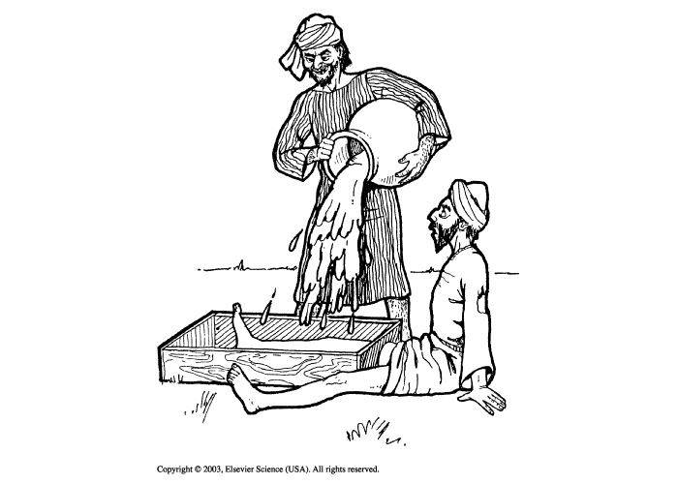
FRACTURE DISEASE

Slide 11
FRACTURE DISEASE
Immobilization with POP tends to result in the limb being motionless, swollen, thin and weak
Prolonged immobilization leads to jt stiffness, mm and ligament atrophy, osteoporosis and irreversible blood and lymphatic vessel damage
Fracture disease therefore are the effects of immobilization and not the effects of the fracture

Slide 12
PREVENTION OF FRACTURE DISEASE
Avoid complete rest
Immobilize only what needs to be immobilized and only as long as really necessary
Correctly tailored immobilization
Start mobilization as soon as possible
Reduce immobilization as soon as possible using e.g. cast bracing, PTBP
Start rehabilitation early

Slide 13
OTHER COMPLICATION OF FRACTURES
GENERAL
Shock
Fat embolus
Venous embolus
Prolonged immobilization
LOCAL
Mal union
Necrosis
Stiffness
Nerve injury
Arterial injury

Slide 14
REHAB IN ORTHOPEDICS
Stages of Rehabilitation
Rest & protection of injured body part
Recover motion
Recover strength
Recover function
Recover skills

Slide 15
PHYSIOTHERAPIST
Enable the body move better
They have to assess for JROM, strength, tone, sensation, mobility status and ADL’s
Rehabilitation can be done during or after immobilization

Slide 16
PHYSIOTHERAPIST
During immobilization
Reduction of edema
Maintain circulation
Maintain muscle function
Avoid muscle dystrophy
Maintain ROM for non involved joints
Maintain function
Ambulation

Slide 17
PHYSIOTHERAPIST
After immobilization
Restore ROM
Restore muscle power
Restore function

Slide 18
PHYSIOTHERAPIST
Physiotherapists are also involved in management of other post traumatic complications e.g.
Myositis ossificans/ heterotropic bone formation- rest in splints/ pain free ROM exes indicated, STM, PM, stretching contraindicated
Volkmann’s ischemic contracture- contracture stretching & splinting

Slide 19
PHYSIOTHERAPIST
Physiotherapists tasks/ activities
Static exercises/ isometric exercises- to prevent disuse atrophy in immobilized muscles
Active assisted exercises- to help improve muscle power with assistance from therapist
Active resisted exercises- to restore muscle power using weights
Passive exercises- to maintain/ restore ROM, maintain muscle length, improve/maintain circulation

Slide 20
PHYSIOTHERAPIST
Passive stretching- to restore lost ROM, restore lost muscle or soft tissue length
Heat therapy- pain management, improve circulation, improve soft tissue flexibility
Cryotherapy- manage acute pain/ swelling
Nerve stimulation- restore the integrity of lower motor nerves, manage paralysis occasioned by lower motor neuron lesions
Elevation- edema, lymph management

Slide 21
PHYSIOTHERAPIST
Scar management- to restore flexibility & tensile strength of soft tissues to pre injury levels
Gait training- depending with the ambulatory aid, 4 point, 3 point, 2 point, swing to, swing through
Balance and coordination exercises/ activities
Pre ambulation- tilt table, parallel bars
Ambulation- depending on weight bearing status of the pt, FWB, NWB, PWB, TTWB, WBAT

Slide 22
OCCUPATIONAL THERAPIST
Are involved in rehabilitation of patients with physical, mental/ social needs due to accidents, illness or ageing
They improve patients ability to undertake ADLs
Those ADLs maybe self care, family roles, work/social activities
They rehabilitate people to regain independence

Slide 23
OCCUPATIONAL THERAPIST
They teach new approaches to accomplish tasks
Task broken down to manageable sections
They also advice about assistive equipments and home adaptations that may be useful
Improving patients ability to fulfill roles helps improve pts motivation, maintain pts roles

Slide 24
OCCUPATIONAL THERAPIST
Also manage injuries through splinting, which can be used as primary or secondary pt management
In primary pt management, splints are used to immobilize injured body parts
In secondary pt management, splints are used to maintain ROM, support injured part during rehabilitation & rest body part post rehabilitation

Slide 25
ORTHOPEDIC TECHNOLOGIST
They make & maintain orthopedic ambulatory and rehabilitation aids
They also repair/ recondition & make adjustments to these rehabilitation aids so as to fit the pts specifications
They also make and fit orthotics & prosthesis that are used by pts with post traumatic injuries

Slide 26
FOLLOW UP FOR REHABILITATION
After initial assessment and treatment, rehabilitation follow up can be done in the following context
In patient
Out patient
Home based care
Community based rehabilitation

Slide 27
PHYSIOTHERAPY MODALITIES- ELECTROPHYSICAL AGENTS
Are used to create the desired physiological effect e.g. increase local temp, reduce nerve conduction
Choice of EPA depends on:-
Specific condition i.e. acute or chronic
Patients needs
Sensory level
Cognitive level
Overall goals

Slide 28
ELECTRICAL STIMULATION
E.G. transcutaneous nerve stimulation (TENS), interferential therapy
Utilizes electrical energy to cause depolarization of mm or nerve tissues
CONTRAINDICATIONS
Deep vein thrombosis
Mental implants
Malignancy
Infections
Active epiphysis
Impaired circulation
Pregnancy

Slide 29
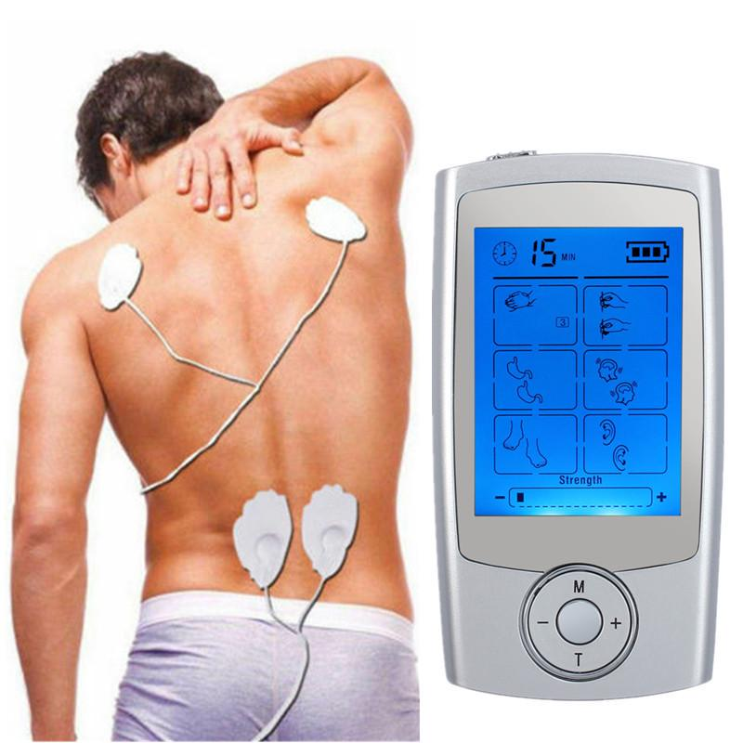
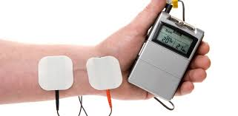
ELECTRICAL STIMULATION

Slide 30
THERMAL/ HEAT THERAPY
Uses hydrocollator packs
Physiological effect of heat is:-
> mm relaxation
< pain
> tissue elasticity
Vasodilatation
CONTRAINDICATIONS
DVT
Impaired cognition
Acute injury
Malignancy
Metal implants
Hemorrhagic conditions

Slide 31
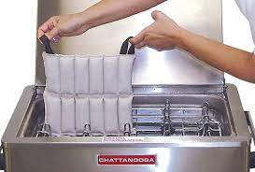
THERMAL/ HEAT THERAPY
CONSIDERATIONS
Sensory integrity of the pt
Always wrap packs with towel
Pt not allowed to lie on top of hot pack as it compresses capillaries

Slide 32
CRYOTHERAPY
Used cold packs, ice, cold spray, cold compressions
CONTRAINDICATIONS
DVT
Impaired circulation
Impaired cognition
Physiological effects of cold:-
Pain relief
< mm spasms
< nerve conduction velocity
Vasoconstriction
< edema

Slide 33
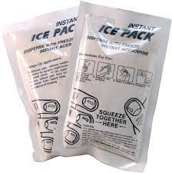
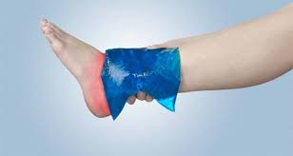
CRYOTHERAPY

Slide 34
ULTRASOUND
Utilizes sound energy
Classified as a deep heating modality used to heat deep sited tissues
Can be paused or continuous
USES
For its thermal effect
Optimizes collagen production
Accelerates rate of # healing by enhancing angiogenic & chondrogenic/ osteogenic activities

Slide 35
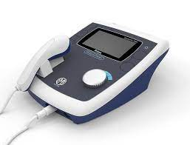
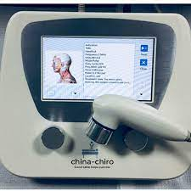
ULTRASOUND

Slide 36
THERAPEUTIC EXERCISES
Mvt prescribed to correct impairment, restore function, and/or maintain well being
Common exes fall into 4 groups:-
Strength exes
Endurance exes
Flexibility exes
Balance/ coordination exes
Exercise prescription should follow:-
F- frequency
I- intensity
T- time
T- type

Slide 37
THERAPEUTIC EXERCISES
Types of therapeutic exes:-
Isotonic- dynamic mvt with constant load
Isokinetic- constant velocity with variable load
Isometric- mm contraction that is static
Stretching- slow, controlled exe that aids in ROM
Stretching exe can be dynamic, static of PNF (proprioceptive neuromuscular facilitation)

Slide 38
AMBULATORY AIDS
Ambulatory aids
Are orthopedic appliances which help pt improve walking pattern, balance, safety
Also used to transfer weight
Ambulatory aid prescription depends with patients stage of recovery or severity of injury
Fall into 4 categories: canes, crutches, walkers, standing frames

Slide 39
PRESCRIPTION
Done after assessment of gait, balance, cognition, neuromusculoskeletal system
Also take into account co- morbidities e.g. HTN
Also whether use of aid is temporary or permanent
Prescription also requires knowledge of wt bearing prescribed to pt i.e. FWB, PWB, NWB, TTWB, WBAT
Also determined by anthropometric parameters e.g. pts wt, height, BMI

Slide 40
PARALLEL BARS
Fixed & Rigid
Used for standing & ambulatory training
Used with a mirror in front
ADVS
Max stability
Corrects posture
Requires less coordination
DISADVS
Stationary
Expensive

Slide 41
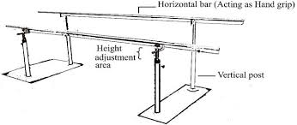
PARALLEL BARS

Slide 42
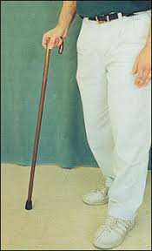
CANES
Most common
Hand held opposite to injured side
Types- standard, tripod, quadrupeds, rolling cane
Can be made of wood, hard plastic, aluminum or steel
Standard cane

Slide 43
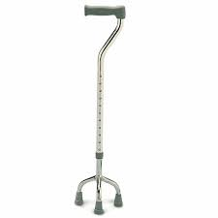
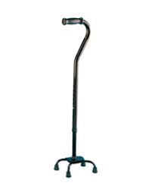
CANES
Tripod
Quadrupeds

Slide 44
CANES
ADVS
> balance & stability
< biomechanical load on lower limb joints
Widens BOS
DISADV
Pt can not perform NWB, PWB

Slide 45
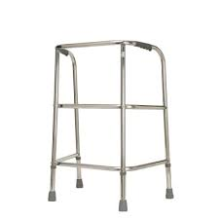
WALKING FRAMES/ WALKERS
Provide greater stability
Provides wider BOS
Types
Standard
Reciprocal
Rollator
Standard

Slide 46
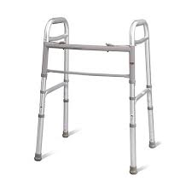
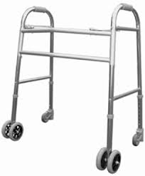
WALKERS
Reciprocal
Rollator

Slide 47
WALKERS
DISADV
Can not be used in a crowded space
Can not be used in stairs
INSTRUCTIONS
Maintain good posture
Avoid moving too close or too far from walker
Not for use with stairs
WT BEARING STATUS
NWB, TTWB, PWB, FWB, WBAT

Slide 48
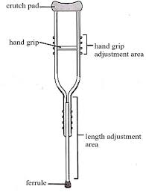
CRUTCHES
2 types: axillary/ underarm & forearm/ elbow crutches
Require upper limb strength & adequate ROM
Axillary/ underarm

Slide 49
AXILLARY CRUTCH
ADVS
Used to > balance
Used to > lateral stability
Used for stairs
DISADV
Needs upper limb strength
Needs trunk support/ stability
MEASUREMENTS
Foot- head linear technique
Arm span technique
Foot- anterior axillary fold linear technique
WT BEARING STATUS
NWB, TTWB, PWB, WBAT, FWB

Slide 50
AXILLARY CRUTCHES
INSTRUCTIONS
Good posture
Avoid leaning on axillary pad so as not to injure delicate structures in the axilla region
Avoid pivoting when turning, use small circles
Axillary pad should be close to chest to > lateral stability
Avoid moving crutches too far, move within arms length

Slide 51
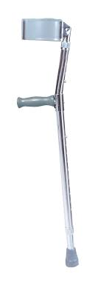
ELBOW CRUTCH
Forearm/ elbow
ADVS
Used to < wt bearing to one limb
Balance, lateral stability
For stair climbing
DISADV
Need upper limb strength, trunk support

Slide 52
ORTHOSIS/ PROSTHESIS
Orthosis- its an external appliance, pre fabricated or custom made, that controls the movement of specific body parts
Prosthesis- is a replacement to either the entire or a part of a body part. Allows pts to perform functional tasks which would otherwise be unable to perform without the limb

Slide 53

ORTHOSIS
Cervical orthosis
Supports occiput & chin to < ROM from C2- C5
Used in stable C spine conditions

Slide 54
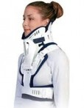
ORTHOSIS
Cervical thoracic orthosis
Provides greater motion restriction to C5-C7 due to increased leverage on pts body
Used for minimally unstable fractures

Slide 55
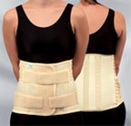
ORTHOSIS
Spine orthosis
Limit motion, correct deformity in reducing axial load or improves function of a spinal segment

Slide 56
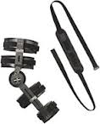
ORTHOSIS
Upper limb orthosis
Restore or improve functional or structural components of body parts
Static orthosis- don’t allow motion
Static/ functional- allow motion

Slide 57

ORTHOSIS
Wrist/ hand orthosis
Begin at fingers & terminate on distal forearm
Provide grasp/ release despite hand paralysis

Slide 58

ORTHOSIS
Knee orthosis/ brace
Strengthen, provide support/ stability or relieve pressure at the knee joint
Can also be static or dynamic

Slide 59

ORTHOSIS
Ankle foot orthosis (AFOs)
Prevent injury, protect previously injured ankle, maintain foot in anatomical position

Slide 60

ORTHOSIS
Foot orthosis
Correct foot deformities, relieve foot pressure & support foot to improve gait
Can be full length or ¾ length

Slide 61

PROSTHESIS
Lower extremity prosthetics
Artificially replaced limbs located at hip level or below
Can be trans tibial (BK) or trans femoral (AK)

Slide 62
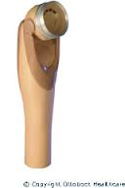
PROSTHESIS
Upper limb prosthesis
Used to improve appearance or ability to perform tasks
The 2 functions conflict with each other
Attractive- less functional
Unattractive- most functional

Slide 63
QUESTIONS???

